Slide 1
Take-Home Project: AI-Powered Alcohol Label Verification App
By: Adrian Olivera
oliveraoliveraadrian@outlook.com

Slide 2
Agenda
Introduction
Application Requirements
Solution
Application Flow
Trade-Offs
Limitations and Next Steps
High-Level Project Plan

Slide 3
Introduction
Persona: TTB compliance agents
Sarah Chen
Dave Morrison
Jenny Park
Responsible for reviewing ~150,000 alcohol label applications per year.
Pain Points:
  Agents spend 5–10 minutes per label doing data verification
  Peak submissions of 200–300 labels must be processed one at a time.
  Agents range from tech-savvy to minimally experienced with digital tools.
  Existing automated systems are too slow or inaccurate, leading agents to revert to manual review.
  Nuances in labels require judgment, making strict pattern matching insufficient.

Slide 4
High-Level Application Requirements
REQ ID | Statement | Source/Rationale
1 | The application shall compare the label artwork with the alcohol application. | Ensure that the label matches what is in the application. (Sarah Chen, Deputy Director of Label Compliance)
2 | The application comparison process shall take less than 5 seconds. | User acceptance criteria. (Sarah Chen, Deputy Director of Label Compliance)
3 | The application shall include human psychological and sensory factors. | These factors help generate an inclusive product suitable for a wide range of ages, expertise levels, and backgrounds. (Sarah Chen, Deputy Director of Label Compliance)
4 | The application shall contain a batch upload capability. | User acceptance request. (Sarah Chen, Deputy Director of Label Compliance)
5 | The application shall function without the usage of cloud APIs. | Government networks block cloud APIs, limiting capabilities. (Marcus Williams, IT Systems Administrator)
6 | The application fields comparison (except for the government warning statement) shall be case-sensitive, italics-agnostic, and bold-agnostic. | This capability may require the use of humans-in-the-loop for AI hard cases. (Dave Morrison, Senior Compliance Agent, 28 years)
7 | The application government warning statement shall follow the rules for the government warning statement as described by TTB. | Government warning statements have strict rules that all alcohol products must follow.

Slide 5
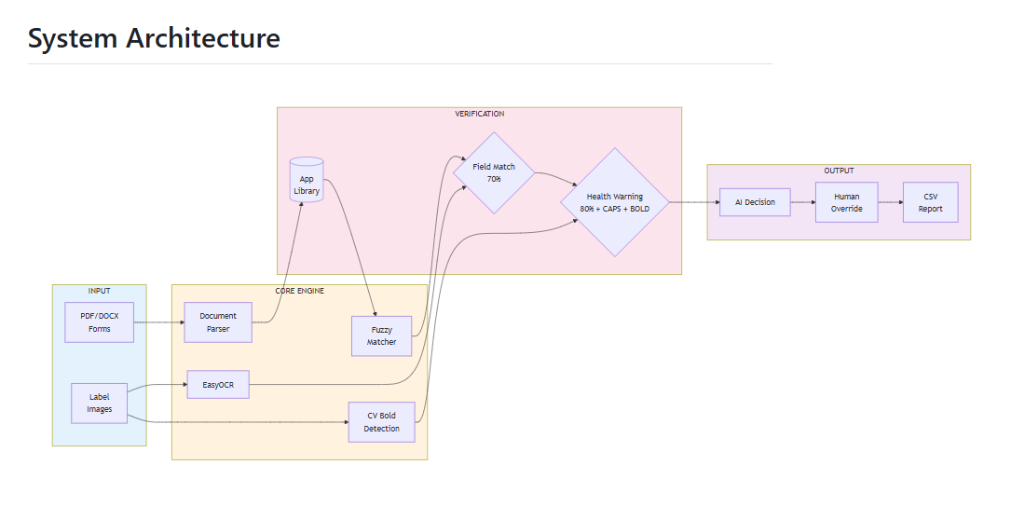
Solution
Goal
Key Value Propositions
Process labels in less than 5 seconds
Supports multiple label uploads simultaneously
Highlights mismatches
Clean and intuitive design
Can handle imperfect images
Impact
Reduces time spent on routine verification tasks
Improves consistency and accuracy across label reviews.
Demonstrates feasibility of AI-assisted label verification for future system modernization without immediately integrating into the COLA system.
Generate a standalone prototype that automates label review by extracting key fields from label images.

Slide 6
Application Flow
app.py
rag_system.py
Start
Initialize OCR
It uses EasyOCR (an Optical Character Recognition engine) to take label images and convert them into machine-readable text data.
Ingest Applications and Create Applications Library
For images, it uses EasyOCR; for PDFs, it uses PdfReader; and for Word documents, it uses DocxDocument.
It starts by recording the processing time. It uses EasyOCR to extract text from images, then applies TheFuzz to compare the extracted text with the data from applications. It finds the best match between the application and the image, compares application fields with image fields, and requires an 80% match for the government warning and 70% for the other fields. For the health warning, it checks, text similarity, formatting requirements, and bold letters using CV bold detection (>4% letters width).
Ingest Alcohol Labels
It shows the average label processing time and displays a comparison table for labels that do not match the applications. It allows the user to override an AI failure, generates a report, and provides the option to download the report.
Analyze and Show Dashboard Metrics
End

Slide 7
Trade-Off for OCR Models
Florence vs EasyOCR
  Florence requires setting up model weights and has a more tedious installation process with additional dependencies compared to EasyOCR.
  Florence provides results comparable to EasyOCR when combined with fuzzy matching.
  The major drawback of Florence is its slow processing speed, with an average runtime of 30s to 40s per alcohol label, making it unacceptable for users.
Decided to use EasyOCR combined with fuzzy matching and CV for bold detection

Slide 8
Limitations and Next Steps
Limitations
Assumes the wine, beer, and spirits applications follow the same format.
The real TTB form not used for this prototype.
Currently, there is no logic to handle exceptions for TTB label requirements.
EasyOCR is only configured for English detection models.
Next Steps / Action Plan
Implement application security best practices.
Ensure compatibility and proper functioning of the application within Azure environments.
Conduct user acceptance testing (UAT) with compliance staff to confirm the application meets functional and regulatory requirements.

Slide 9
High-Level Project Plan
Phase 1: Initiate / Requirements Gathering
1
Define scope, gather stakeholder needs.
Phase 2: Design
2
Create architecture, workflow, and UI mockups.
Phase 3: Build
3
Implement AI label verification, batch upload, and tests.
Phase 4: Deploy in Test Environment
4
Functional testing, UAT, performance checks.
Phase 5: Deploy to Production
5
Integrate with systems, ensure security and compliance.

Slide 10
Source Code
Github: https://github.com/oliveraoliveraadrian/AI_Alcohol_Label_Verification.git
Application URL: https://ai-powered-alcohol-label-verification-app-d4gm.onrender.com

